Slide 1
Student Performance Analysis
Group 10 - An Hu, Jason Obiechefu, Moksha Shah
Our data shows high school student performance between two schools in Portugal. Both schools had very similar grade outcomes, so we decided to use the data from both schools to determine what factors contribute most to student absenteeism and grades.
Notes:
Data shows performance and different factors of students from two schools in Portugal. We are looking at this data to try and uncover if certain variables have significant impact on student’s grades such as travel time, study time, number of failures, school support, family support, school activities, health, number of absences, compared to their overall grades. We are looking for the factors that have the most significant effect on absenteeism and grades.

Slide 2
Marketing Question:
Sub-Questions:
What products or services can decision-makers within education allocate their budget towards to improve student grades and attendance?
What factor has the biggest effect on grade performance?
Are there any key differences in attendance between the upper and bottom 25th quartiles?
After forecasting attendance to grade performance in the upper and bottom 25th quartiles, is there a significant difference?
Notes:
As marketers, the question we want to answer from the data is:
What factors most influence student absenteeism and grade performance, and what products and services can decision-makers within education allocate their budget toward to improve student grades and attendance?
We will analyze correlations and regressions between different categories to unveil where there is significance, and then forecast performance based on highest and lowest attendances and grade performances.

Slide 3
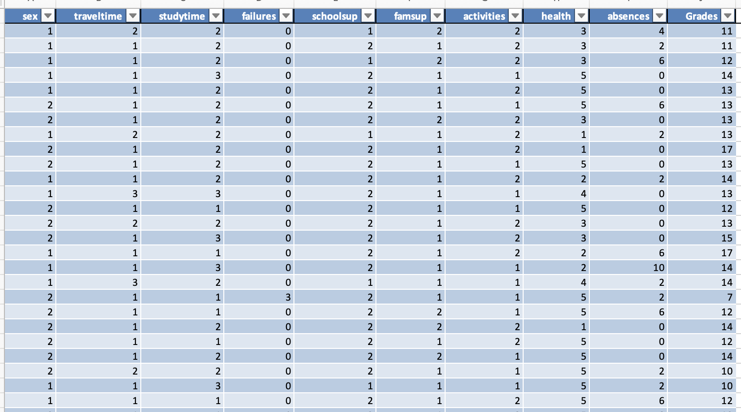
Sex- Female 1 Male 2 School support- Yes 1 No 2 Family support- Yes 1 No 2 Activities- Yes 1 No 2 Travel time- in hours Study time- in hours Failures- number of failures Health- 1-5 rating Absences- number of absences Grades- mean: 12; median: 12; mode:11
Our Cleaned Dataset
649 Rows 10 Columns
Notes:
This is a snapshot of our dataset that merged the performances of both schools.
The mean of total exam scores is 12; the median exam score is 12; the mode of exam scores is 11.
Some categorical data were converted to numerical standards, such as binary data like gender, and yes/no data including having family support, school support, or engaging in after-school activities.
We formatted other data to reflect a range within travel and study time, number of previous failed classes and absences, and a rating for health.

Slide 4
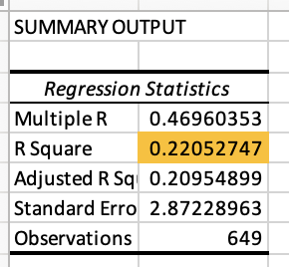
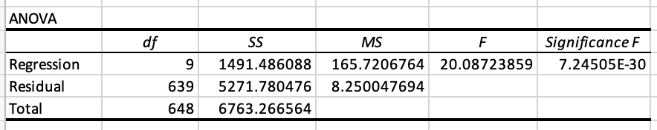
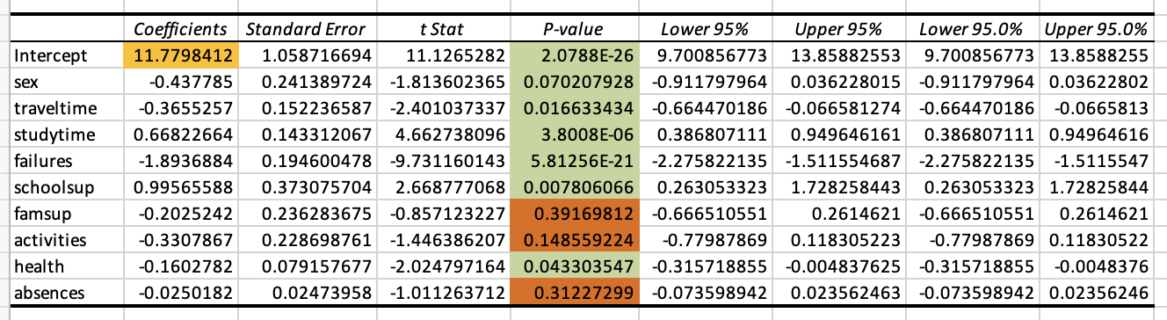
Multiple Regression Analysis
Notes:
In the multiple regression that was run we see an R-Square of .22. R-square represents the proportion of variance in the dependent variable explained by the independent variables. Higher R-Square: Indicates a better fit of the model to the data. This R-Square number is not significantly high.
The Intercept is 11.78 revealing the dependent variables may not account for all nuances when it comes to student test scores–we may use this data to develop other insights to dependent variables to measure.
Most of our P-values are in a significance range: <0.05 with the exception of three (3) variables: famsup (.392), activities (.148), and absences (.312)

Slide 5
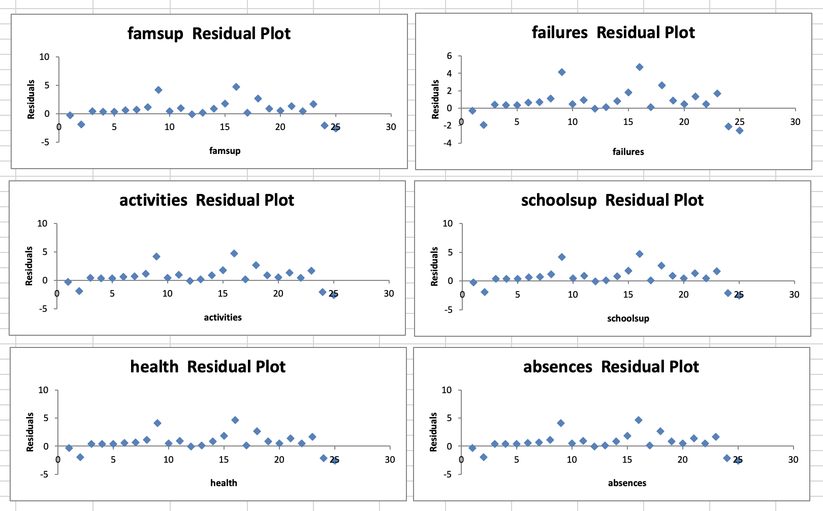
Residual Plot Analysis
These six plots show a relatively random scatter of residuals around zero with no strong patterns.
This indicates that the model likely fits the data reasonably well, and there is no clear indication of non-linearity or heteroscedasticity that would require corrections.
Notes:
The analysis included six different plots showing the residuals of the model. The residuals were randomly scattered around zero without any strong patterns. This suggests that the model fits the data reasonably well, meaning there’s no clear need for corrections related to non-linearity or heteroscedasticity issues.
Overall, the data analysis indicates that multiple factors influence student grades, and the model used is capable of capturing the underlying trends adequately.
Famsup Residual Plot:
The residuals appear somewhat randomly scattered around zero but do show some minor clustering and variation in spread at different levels of famsup. While not showing a strong pattern, there is some mild unevenness in the spread, which might indicate slight heteroscedasticity.
Failures Residual Plot:
The residuals here also appear scattered around zero with a few slightly more dispersed points as failures increases. The plot doesn’t show a clear pattern, which suggests a reasonable fit. However, there is minor spread in the residuals, which could be worth watching if it affects other predictors.
Activities Residual Plot:
The residuals for activities are scattered reasonably around zero with no significant pattern. The spread of residuals looks fairly consistent across different levels of activities, indicating that this predictor is likely behaving well in terms of linearity and homoscedasticity.
Schoolsup Residual Plot:
There’s a somewhat consistent spread of residuals around zero with no clear pattern, which is good. However, there are some slight fluctuations in spread as schoolsup increases, but overall, the residuals don’t show a strong funnel shape or pattern. This suggests an acceptable fit.
Health Residual Plot:
The residuals for health show a relatively random scatter around zero without an obvious trend or pattern. The spread of residuals seems consistent across values, suggesting homoscedasticity. This plot indicates that health is likely a well-behaved predictor in the model.
Absences Residual Plot:
The residuals for absences appear randomly scattered around zero with no apparent pattern or trend. There is also a consistent spread, suggesting that this predictor likely satisfies the assumptions of linearity and homoscedasticity.

Slide 6
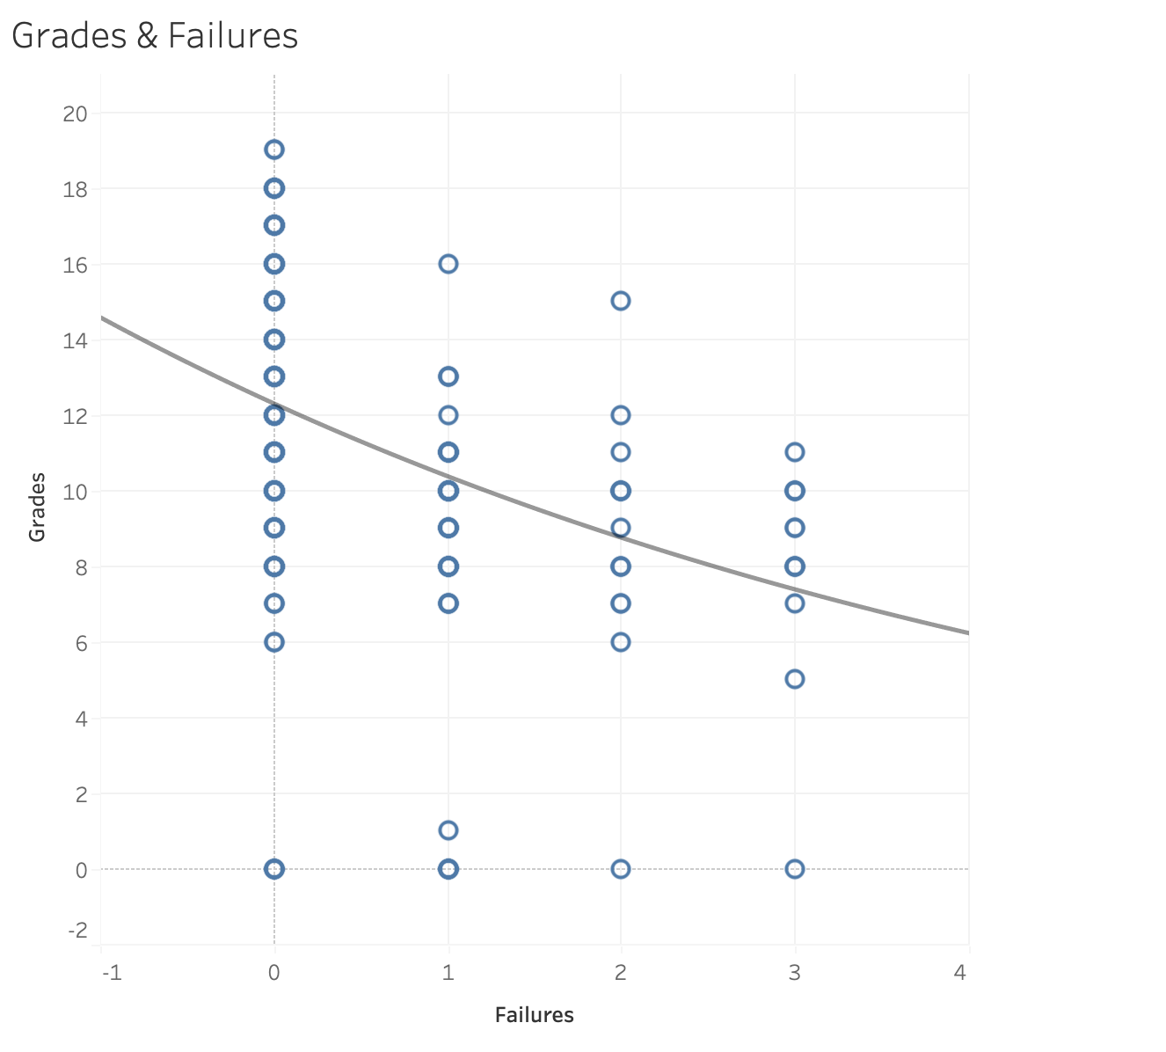
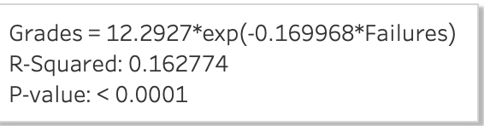
Failure Having An Impact On Grades
Comparatively to other factors Failures had the strongest negative correlation. Our trendline shows that students who failed at least once do not receive top scores, and the top score drops as there are more failures.
Notes:
Failures had a strong negative correlation with grades. Students who had at least one prior failure tended to have lower scores compared to their peers.
As the number of failures increased, the likelihood of achieving top scores significantly decreased. This trendline underscores the importance of providing targeted support for students who have previously failed to prevent further academic decline.

Slide 7
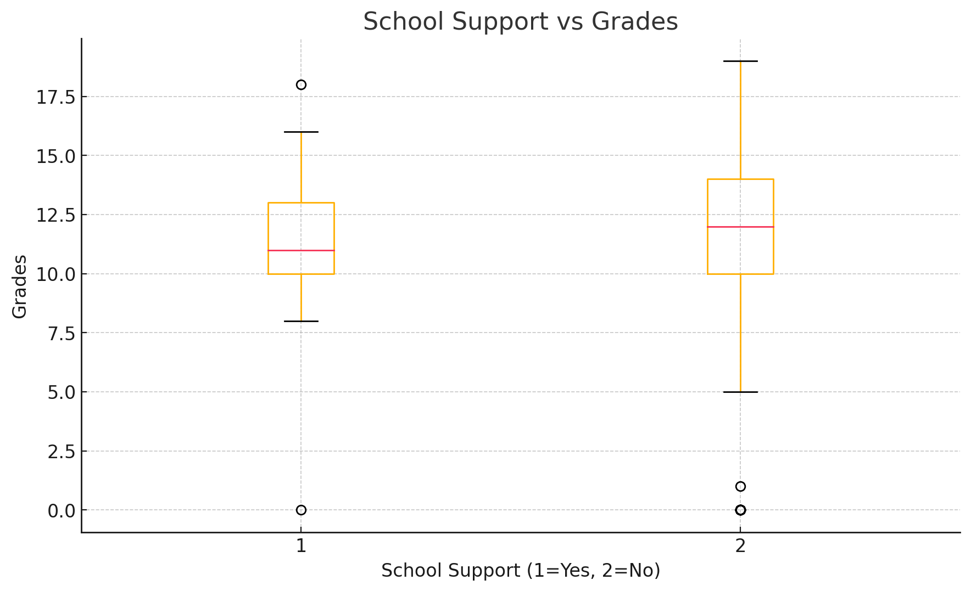
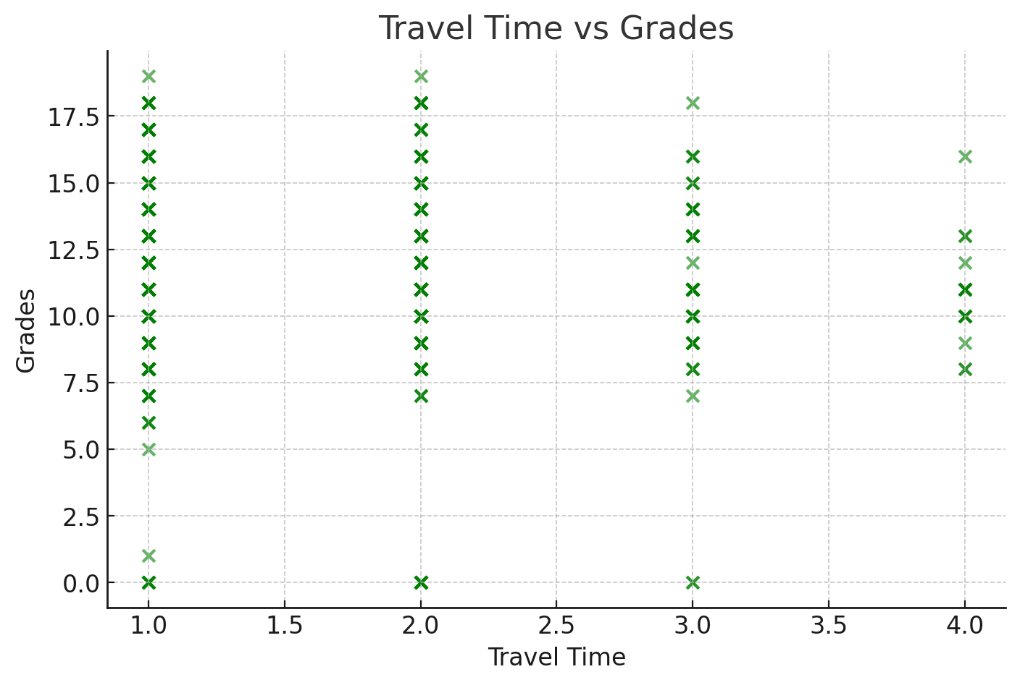
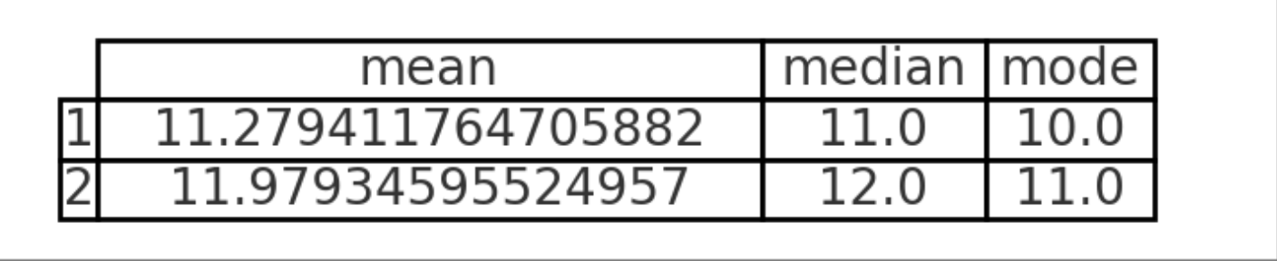
Time Travel & Grades
School Support & Grades
Notes:
School Support & Grades - The analysis shows that students who received school support generally performed better in their exams compared to those who did not. School support here refers to additional help provided by teachers or through specialized school programs aimed at helping students who need extra academic assistance.
The positive correlation suggests that when schools provide structured, targeted support systems, students have a greater chance of improving their grades and performing well academically. This emphasizes the importance of investing in educational support services, such as tutoring sessions, after-school programs, or counseling.
Travel Time & Grades - The relationship between travel time and grades was found to be negatively correlated, with longer travel times impacting students' academic performance. This is likely because students with extended commute times have less available time for studying, completing assignments, and resting, all of which are crucial for good academic performance.
Students spending more than four hours commuting face the greatest challenges, as the long travel reduces the time they can dedicate to schoolwork and also affects their overall energy and focus during school hours.
The scatter plot showed some outliers, indicating that while most students experienced reduced academic performance with longer travel, a few students were able to manage long commutes without a severe impact. Understanding what enables these outliers to perform well (e.g., better time management, supportive environments) might provide additional insight.

Slide 8
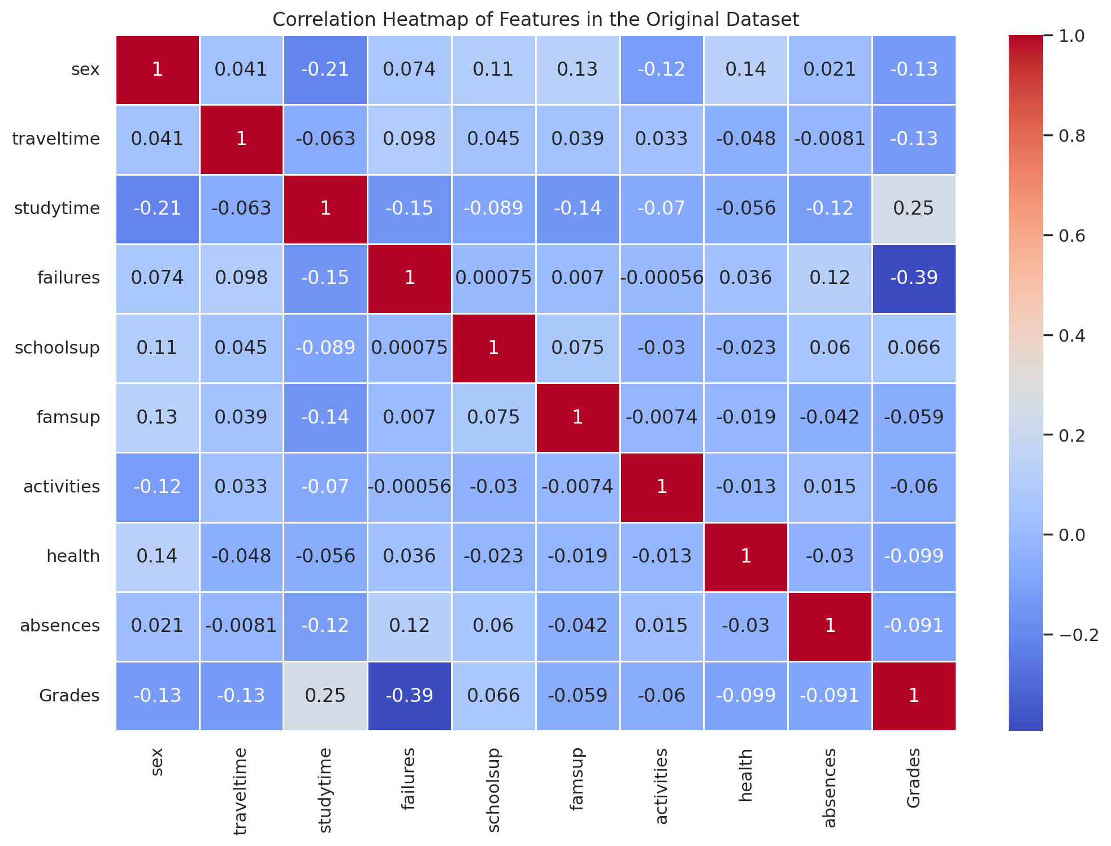
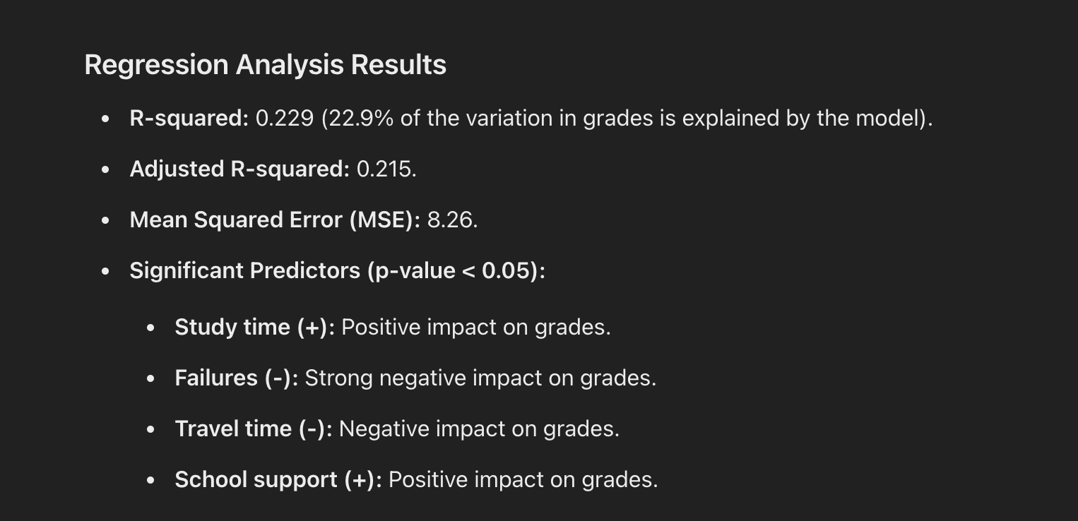
Multiple Regression & Correlation Analysis in AI
Notes:
Chat GPT link- https://chatgpt.com/share/673a6dc4-3614-800a-8eb6-23917765831f
The heatmap helps visualize which factors have the most and least influence on student grades, providing a clear overview of where efforts to improve student outcomes might be most effective.
Study Time has a positive correlation with grades (0.25), reinforcing our earlier findings that more study time is linked to better performance.
Failures show the strongest negative correlation with grades (-0.39), indicating that past failures significantly decrease academic outcomes.
Travel Time and Sex also have slight negative correlations with grades (-0.13 each), suggesting that gender and longer commutes can be factors affecting student success.
School Support shows a small positive correlation (0.066), indicating that students who receive additional support generally perform better, though the effect is modest.
The MLR analysis from chatgpt explains that about 22.9% of the variation in grades, which means some factors that impact student performance may still be unaccounted for. The Mean Squared Error is 8.26, indicating the average deviation between predicted and actual grades.
We identified four significant predictors of student performance:
Study Time has a positive impact on grades—more study time correlates with higher grades.
Failures have a strong negative impact—students who failed before tend to have lower scores.
Travel Time also negatively impacts performance—longer commutes lead to lower grades.
School Support positively affects grades, highlighting the importance of school resources in boosting academic success.

Slide 9
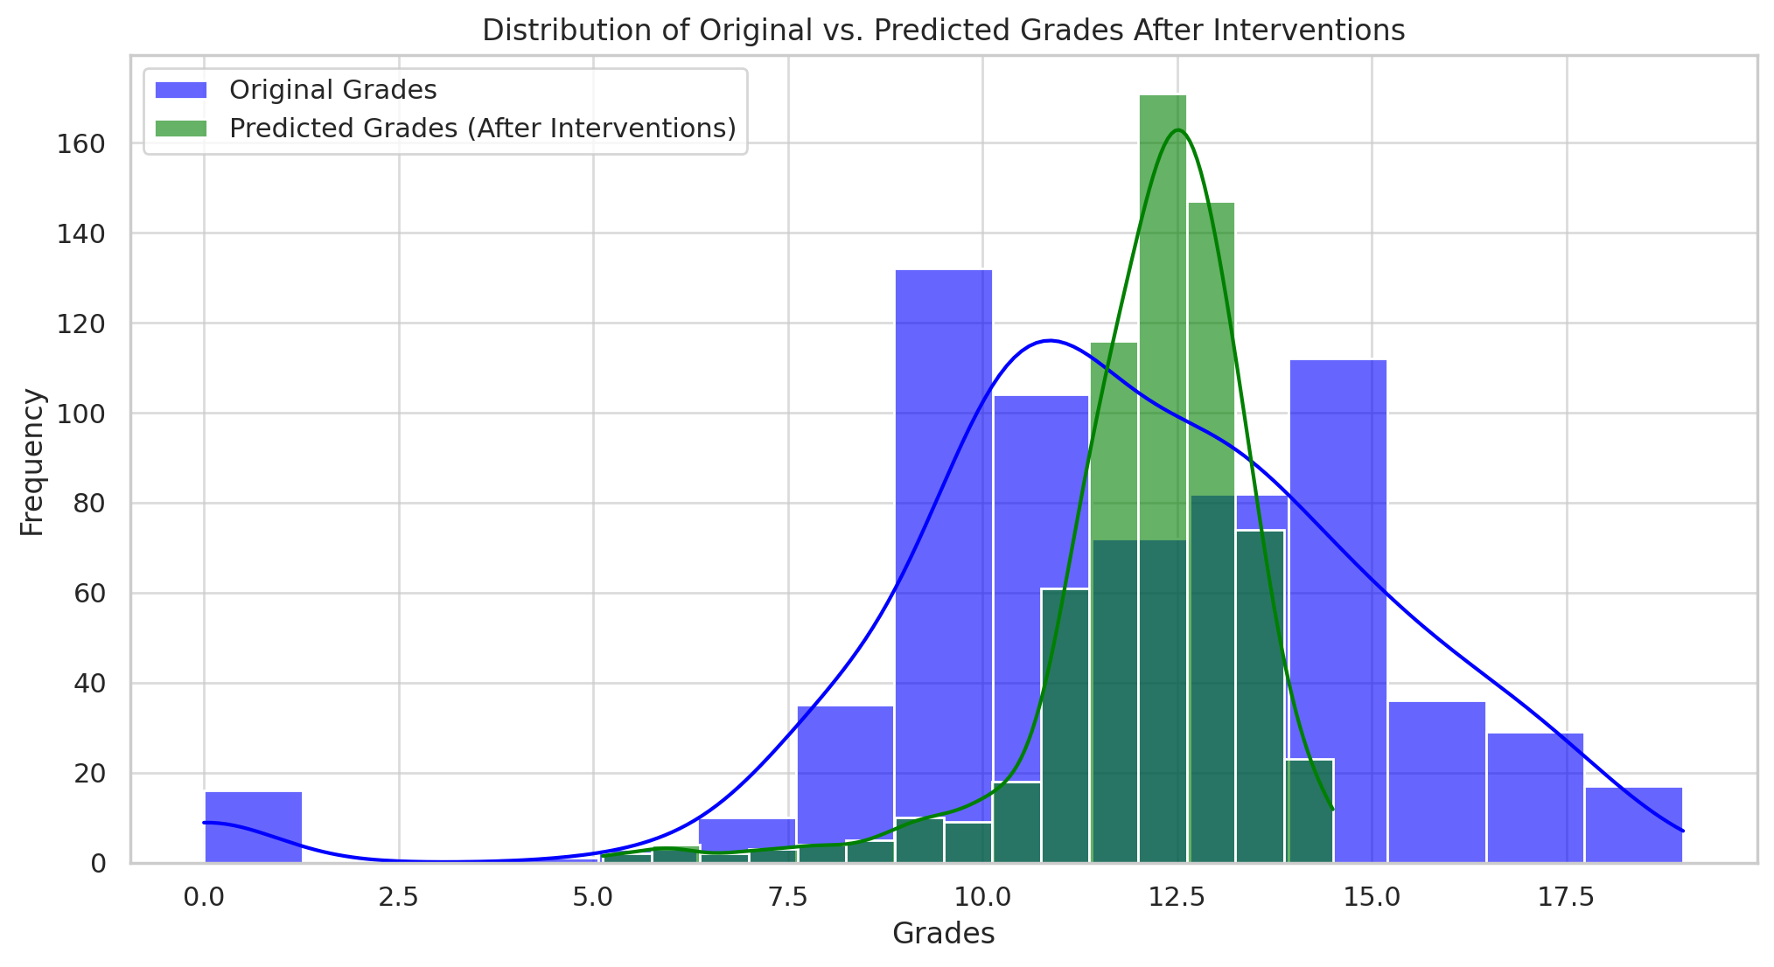
Recommendations
Support After Failure: Allocate extra resources for students who fail in the first quarter to ensure they get the help they need in the second quarter. This can help them catch up and prevent them from falling further behind.
Extra School Support: Providing additional support through in-school study programs can have a significant positive impact on grades. Schools should invest in tutoring programs and support services to assist struggling students.
Improved School Access: Partner with local transportation agencies or provide a school bus to improve access to schools can help reduce the negative impact of long commutes on student performance.
Flexible Hybrid Learning Model: For students with a commute time of four hours or more, a hybrid learning model may help alleviate some of the challenges related to travel and give them more time to focus on their studies
Top 25 quartile of grades students had less failure, and lower travel time compared to the bottom 25 quartile
Notes:
Support After Failure: Allocate extra resources for students who fail in the first quarter to ensure they get the help they need in the second quarter. This can help them catch up and prevent them from falling further behind.
Extra School Support: Providing additional support through in-school study programs can have a significant positive impact on grades. Schools should invest in tutoring programs and support services to assist struggling students.
Improved School Access: Partnering with local transportation providers to improve access to schools can help reduce the negative impact of long commutes on student performance.
Flexible Hybrid Learning Model: For students with a commute time of four hours or more, a hybrid learning model may help alleviate some of the challenges related to travel and give them more time to focus on their studies.
Based on these recommendations, we asked AI to see if it can predict future grades if the above suggestions are applied. The histogram shows the distribution of grades before and after the interventions. The predicted grades (green) are shifted slightly to the right, indicating an overall improvement in grades after the suggested changes were implemented.

